Slide 1
Multiscale modeling of the cardiovascular deconditioning during spaceflight
Stefania Scarsoglio¹
Caterina Gallo¹, Luca Ridolfi²
¹Department of Mechanical and Aerospace Engineering, Politecnico di Torino, Torino, Italy
²Department of Environmental, Land and Infrastructure Engineering, Politecnico di Torino, Torino, Italy
72nd Annual Meeting of the APS Division of Fluid Dynamics
November 23-26, 2019, Seattle, Washington, USA

Slide 2
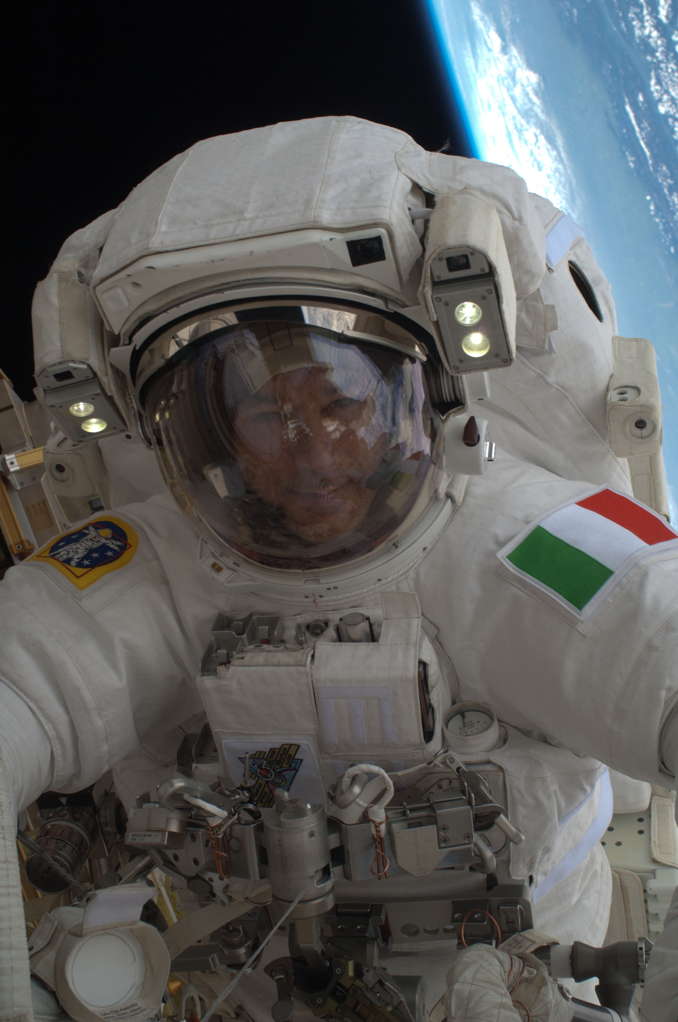
Background & State of the Art
Long-term spaceflight leads to a constellation of cardiovascular changes, which concur to define cardiovascular deconditioning.
The 0G adaptation point is correlated to the level of orthostatic intolerance on reentry and poses unsolved issues regarding the optimal countermeasure program, exercise capacity and re-adaptation for spaceflights beyond 1 year.
Despite ground-based and in vivo measures, several hemodynamic aspects of the 0G spaceflight configuration are so far unclear, contrasting and hardly measurable (e.g., right heart, organ blood supply and oxygen consumption).
Multiscale modeling approach comparing 1G supine condition and 0G spaceflight to: (i) understand the underlying mechanisms leading to cardiovascular deconditioning; (ii) describe the hemodynamics of districts for which clinical data are not feasible and accurate.
Luca Parmitano EVA

Slide 3
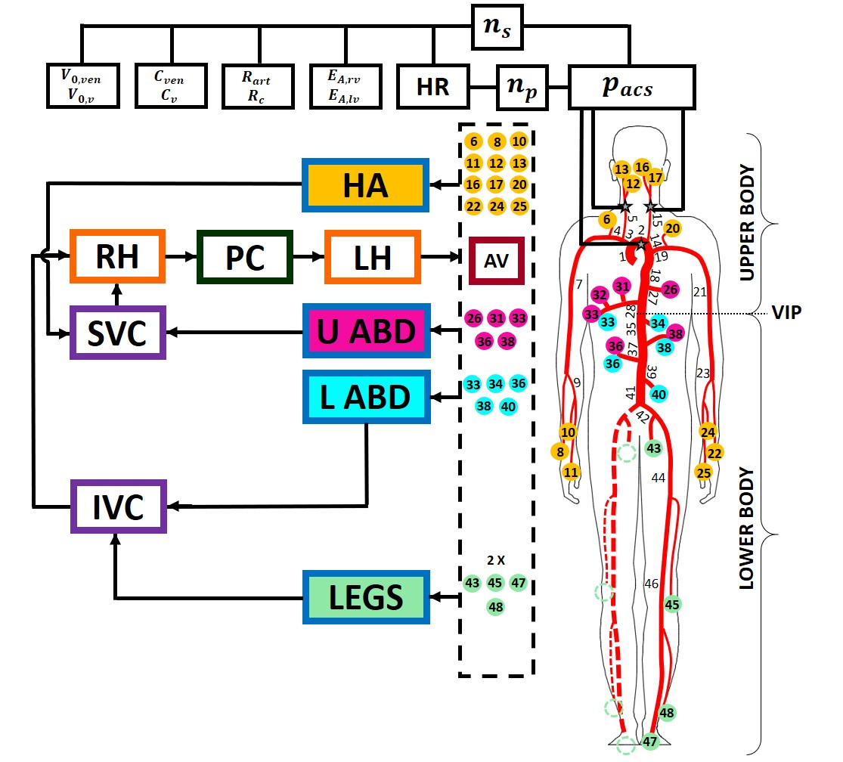
Methods: multiscale model
Baroreflex
1D model: Large and medium arteries;
Axisymmetric vessel geometry and flow field;
Impermeable and tethered arterial walls;
Newtonian, laminar and incompressible blood;
0D model: Arterioles, capillaries, venous return, pulmonary circulation, heart;
Network of resistances (viscosity), compliances (elasticity), inductances (inertia);
Baroreceptor model;
Fluid dynamics variables:
Pressure P, Volume V (Area A), Flow rate Q;
Governing equations for each region:
Continuity and momentum equations;
Constitutive relation between P and V (or A).
1D
0D
Interface
0D-1D

Slide 4
Methods: 0G spaceflight setting
Based on hemodynamic spaceflight data → Long-term (e.g., 6 months) spaceflight conditions without ad hoc countermeasures;
Comparison between:
→ Supine 1G condition (blue) vs Long-term spaceflight 0G (red)
Cardiovascular mechanisms | Modeling changes
Blood volume shift | 470 ml: Lower body volume ↓, Upper body volume ↑
Blood volume reduction | - 11.5% total blood volume
Cardiac function | Ventricular and pulmonary compliances ↑, heart volume ↓
Legs venous compliance | +27%
Arterial resistances | Vertebral and carotid arteries: +10%, Lower body: -10%
Baroreflex response | Baseline HR: +13%, Baseline pressure: -10%

Slide 5
Results: hemodynamic and cardiac parameters
 | Variable | Supine 1G | 0G | % Change | Literature
Cardiac contractility and performance | V_{lves} [ml] | 48.43 | 50.73 | +4.75% | /
 | V_{lved} [ml] | 123.96 | 112.43 | -9.30% | [-5,-13]%
 | SV [ml] | 75.54 | 61.70 | -18.32% | [-14%,-23%]
 | EF [%] | 60.93 | 54.88 | -9.93% | [-5%,-11%]
 | CO [l/min] | 5.67 | 5.24 | -7.58% | /
Cardiac work | SW/min [J/min] | 80.01 | 64.58 | -19.29% | /
Central blood pressure | P_{syst} [mmHg] | 121.03 | 104.82 | -13.39% | /
 | P_{dias} [mmHg] | 69.99 | 65.16 | -6.90% | /
 | MAP [mmHg] | 87.01 | 78.38 | -9.92% | [-2%,-10%]
Oxygen consumption | TTI/min [mmHg s/min] | 2590 | 2373 | -8.38% | /
 | RPP [mmHg/min] | 9078 | 8905 | -1.91% | /
Waveform analysis | AI | 0.17 | 0.10 | -41.18% | /
 | PP [mmHg] | 51.04 | 39.66 | -22.30% | /

Slide 6
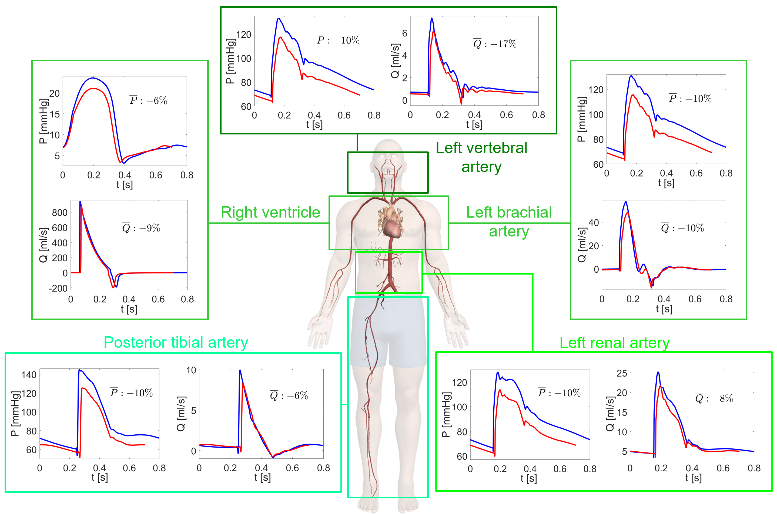
Results: pressure and flow rate mean levels
Mean values per beat:
_
P = ∫P(t)dt/RR [mmHg]
_
Q = ∫Q(t)dt/RR [ml/s]
_
P changes homogeneous throughout the body → increased legs vein compliance;
_
Q is ruled by resistance variations → lower body Q is enhanced, upper body Q is contrasted;

Slide 7
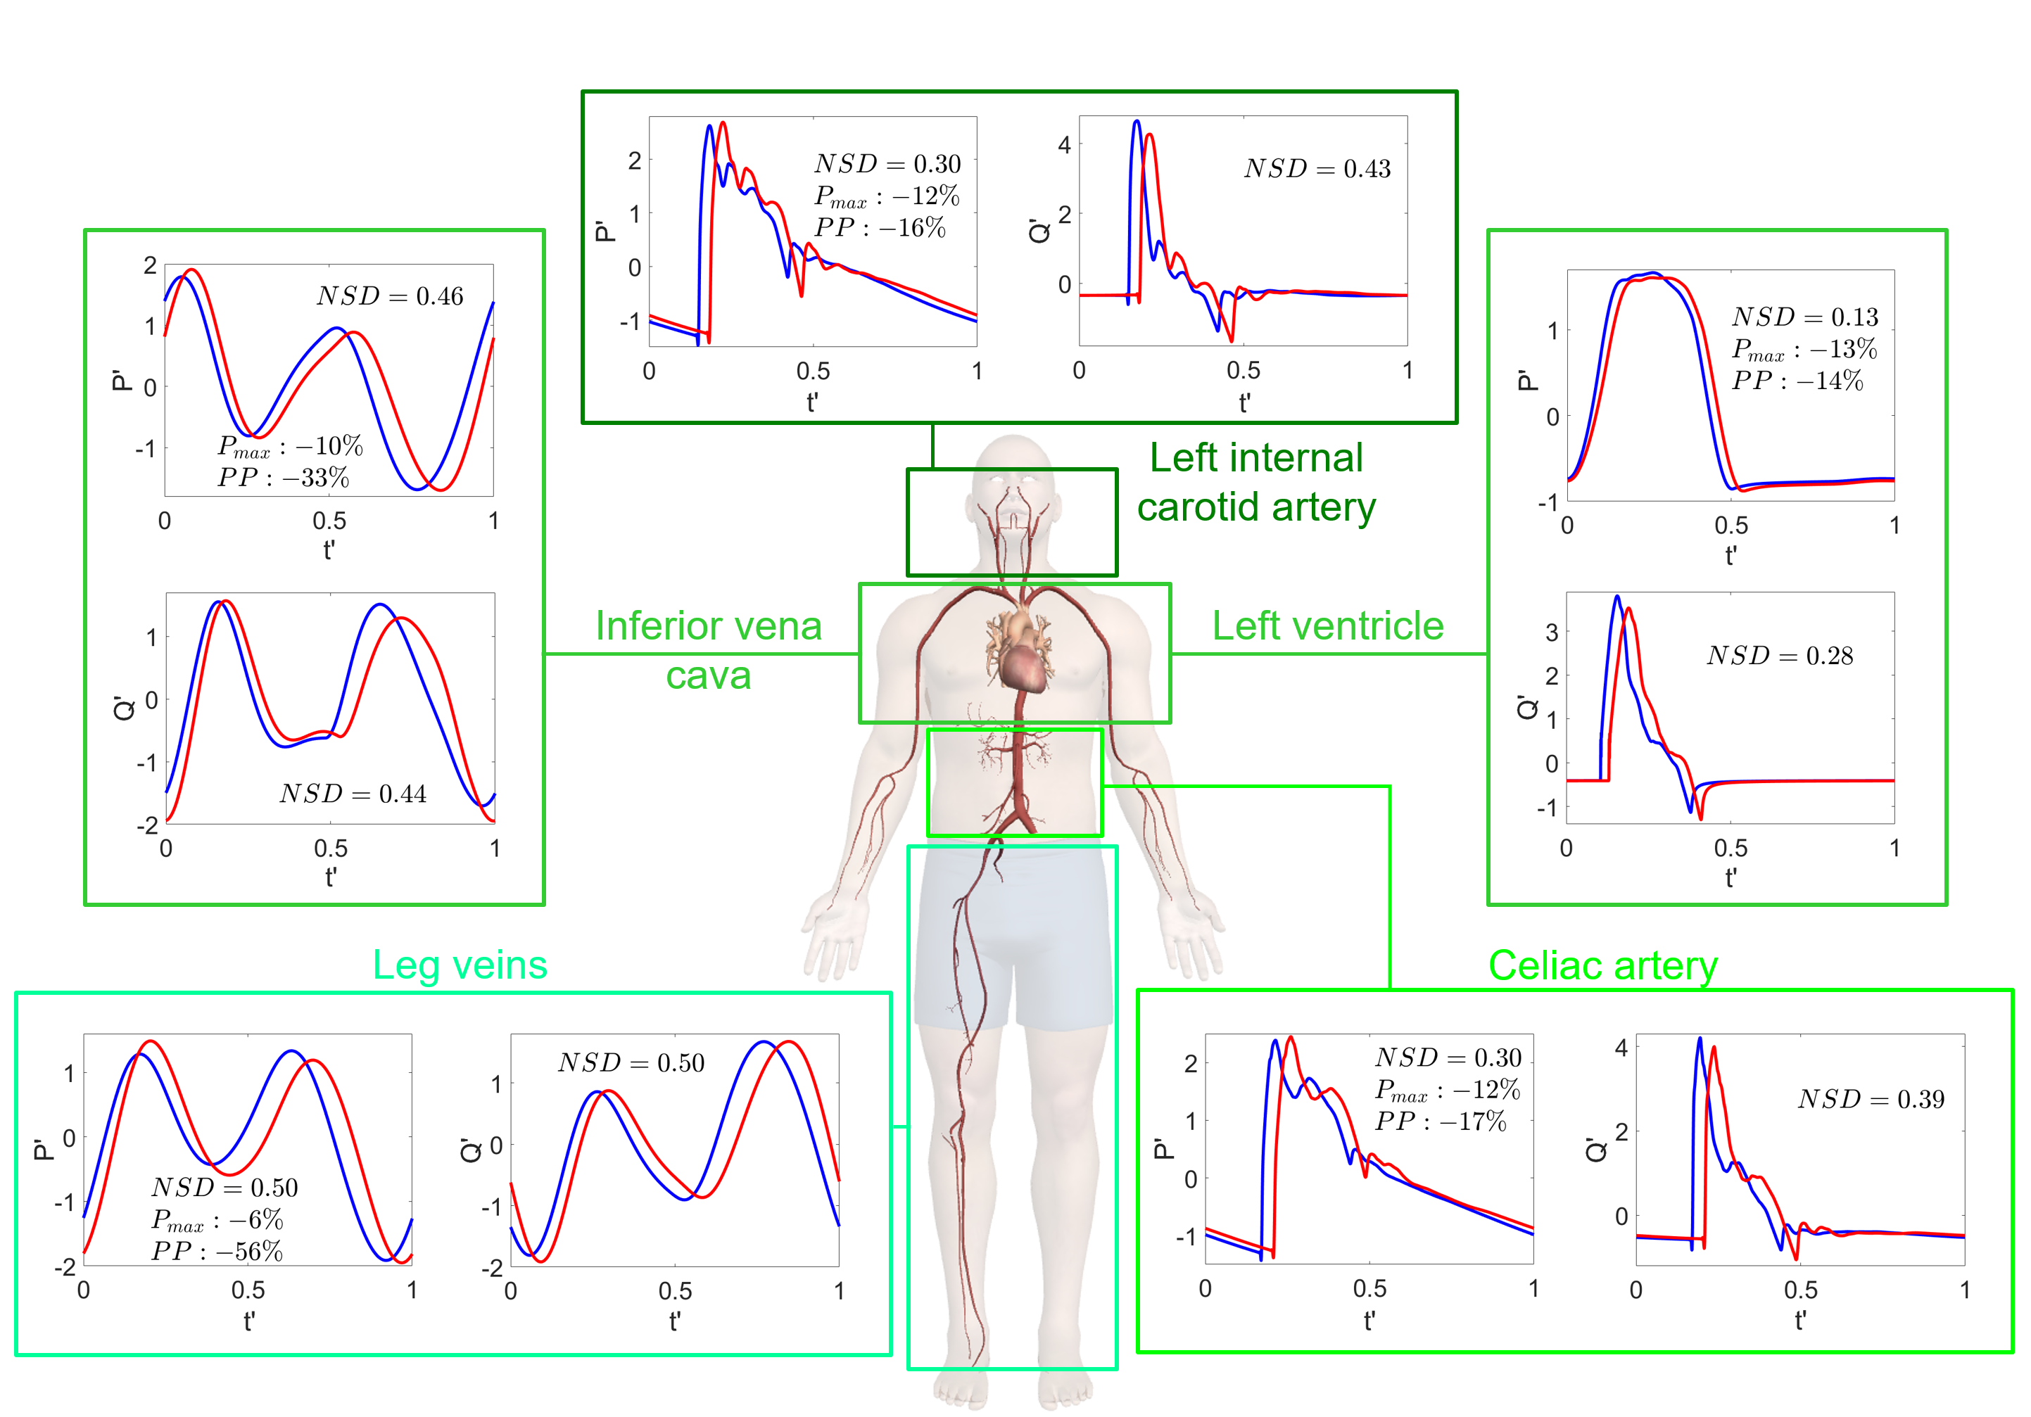
Results: waveform alterations
Waveform parameters:
NSD = ∫|y’_{1G} – y’_{0G}|dt’
t’=t/RR, y’=(y-µ)/σ
P_{max}, PP = P_{max} – P_{min}
NSD is higher for Q’ than P’;
P_{max} variations higher in arterial than venous districts;
Highest PP variations in arteriole-venule regions.

Slide 8
Discussion & Conclusions
Cardiac work, oxygen consumption and contractility indexes, central mean and pulse pressures reduce → cardiac deconditioning;
Configuration of relaxation and sedentary lifestyle due to: (i) direct fluid dynamics effects; (ii) overall less challenging 0G environment;
Waveform variation (horizontal and vertical stretching) → alteration of regular perfusion, mean pressure per beat, and average nutrient supply at the cellular level;
Cardiovascular scenario in 0G is not per se dramatic (e.g., clinically relevant contractility reduction if EF drops more than 20%) → less demanding adaptation point;
The 0G cardiovascular framework becomes hazardous in view of:
Reentry on Earth or partial gravity restore (e.g., Moon/Mars);
High request of exercise tolerance and physical capacity;
→ Special attention to long missions asking for prompt physical capacity after landing.

Slide 9
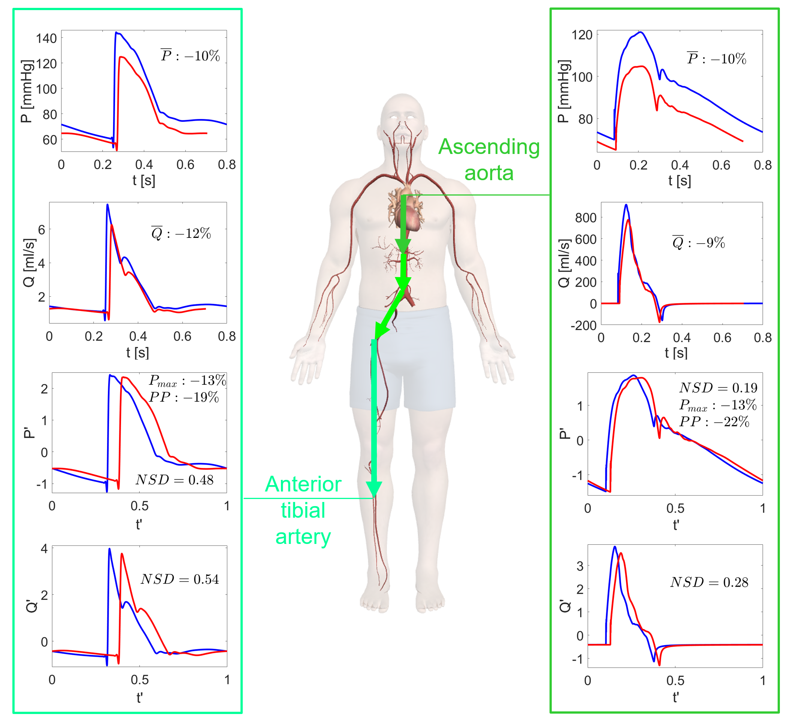
Results: arterial proximal-to-distal tree

