Slide 1
To what extent does heart rate alter the cerebral hemodynamic patterns during atrial fibrillation?
Stefania Scarsoglio¹
Luca Ridolfi², Andrea Saglietto³, Matteo Anselmino³
^{1,2}DIMEAS/DIATI, Politecnico di Torino, Italy
³Division of Cardiology, “Città della Salute e della Scienza di Torino” Hospital, Department of Medical Sciences, Università di Torino, Torino, Italy
15th Mediterranean Conference on Medical and Biological Engineering and Computing
September 26-28, 2019, Coimbra, Portugal

Slide 2
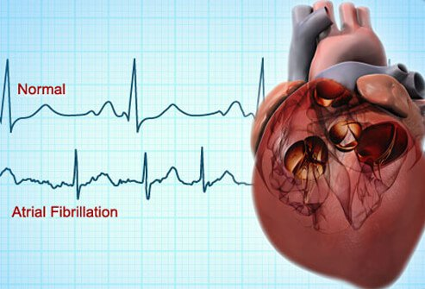
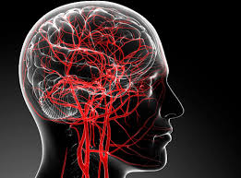
Background & State of the Art
Atrial fibrillation (AF)
Common arrhythmia: irregular and faster beat;
33.5 million people worldwide in 2010 (to be doubled in 40 years);
Disabling symptoms and reduced quality of life;
$ 6.65 billion/year in the USA (2006);
Dementia
Neurological degeneration: loss of memory, socio-cognitive alterations;
81 million people worldwide in 2040;
Healthcare burden: 2 trillion $ worldwide (2030);
Common risk factors with AF (e.g., age, genetics);
Recent independent association between AF and dementia:
Potential hemodynamic mechanisms: microembolisms, altered cerebral blood flow, hypoperfusion and microbleeds.

Slide 3
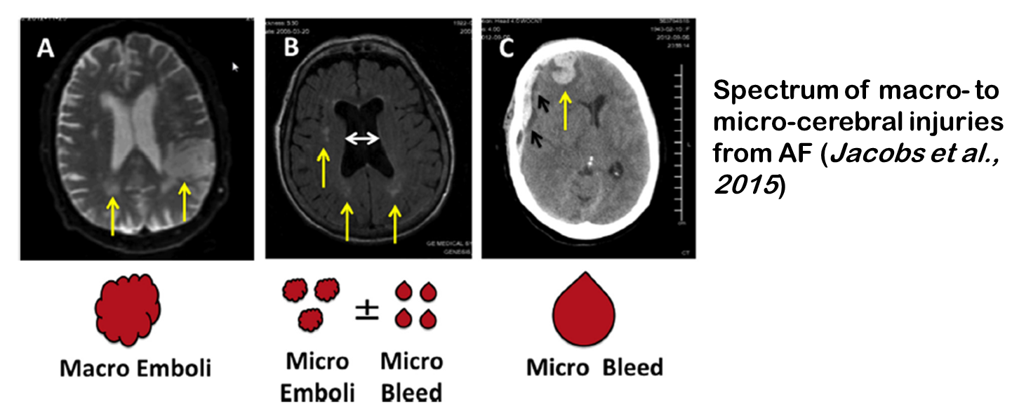
Background & State of the Art
Open questions
Linking mechanisms between AF and dementia;
Consequences of AF rate/rhythm control on cognitive decline;
Lacking clinical measures in the cerebral microcirculation.
Modeling approach for the cerebral hemodynamics during AF
Anselmino et al., Sci. Rep., 2016
Scarsoglio et al., J. R. Soc. Interface, 2017
Scarsoglio et al., Chaos, 2017
Saglietto et al., Sci. Rep., 2019
Impact of heart rate (HR) on the cerebral hemodynamics during AF

Slide 4
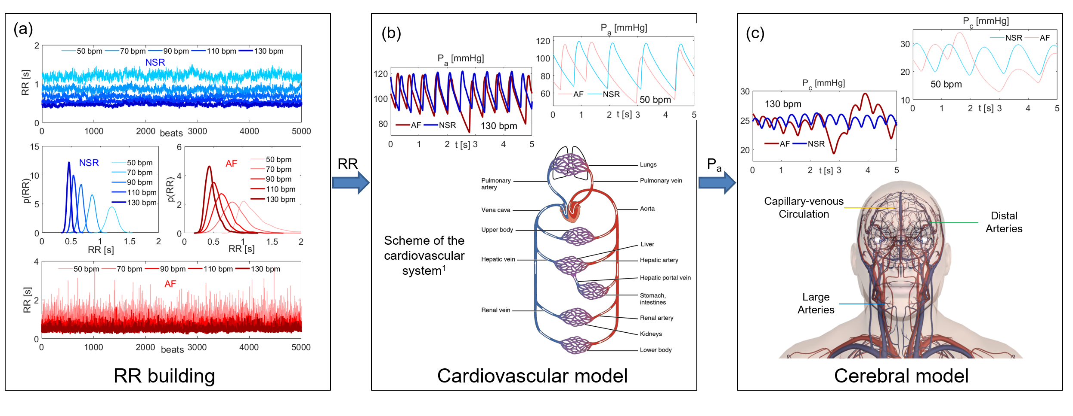
Methods: computational algorithm
Stochastic RR beating extraction and validated lumped modeling;
Mean HR = 50, 70, 90, 110, 130 bpm;
NSR (normal sinus rhythm, blue) and AF (red);
5000 cardiac cycles (RR beats) simulated for each configuration.

Slide 5
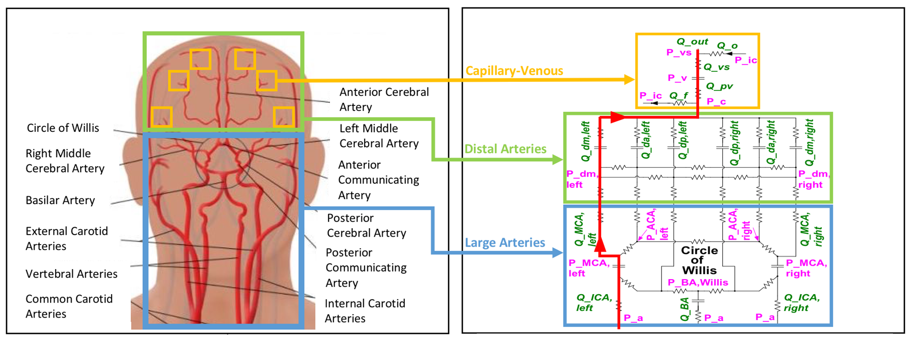
Methods: RR building and lumped modeling features
Artificially extracted beating RR reproducing in vivo ECG
→ higher variability and reduced correlation in AF;
Lumped modeling at glance
Fluid dynamics variables: pressure P, volume V, flow rate Q;
Network of resistances → viscosity, compliances → elasticity, inductances → inertia.
Governing equations for each region:
Continuity equation
Momentum equation
Constitutive relation between P and V
Baroreceptor, autoregulation, and CO₂ reactivity mechanisms;
Focus on the proximal-to-distal pathway (left side):
Large arteries (P_{a}, P_{MCA,left}, Q_{ICA,left}, Q_{MCA,left});
Distal arteries (P_{dm,left}, Q_{dm,left});
Capillary-venous circulation (P_{c}, Q_{pv}).

Slide 6
Methods: percentile and crossing time analyses
Percentile analysis: to which AF percentiles the values individuated by 5th and 95th percentiles in NSR correspond How AF modifies the probability of extreme events.
Crossing time T_{cr}: temporal interval consecutively spent above or below the threshold individuated by the mean value in NSR How AF influences the excursions.

Slide 7
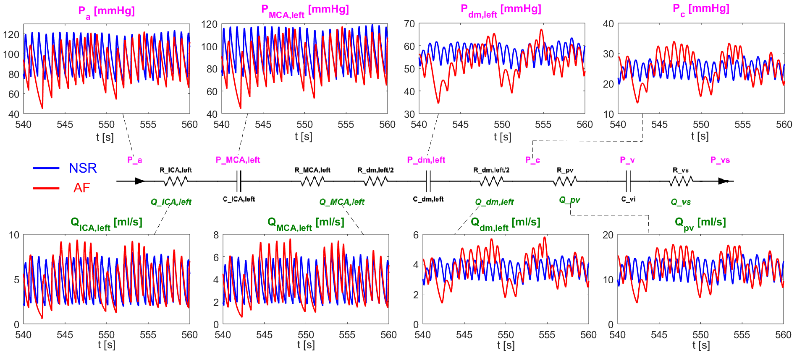
Results: proximal-to-distal pathway
At fixed HR (here 70 bpm) and compared to NSR, AF triggers a higher variability of the cerebral hemodynamic variables, increasingly proceeding towards the distal circulation.

Slide 8
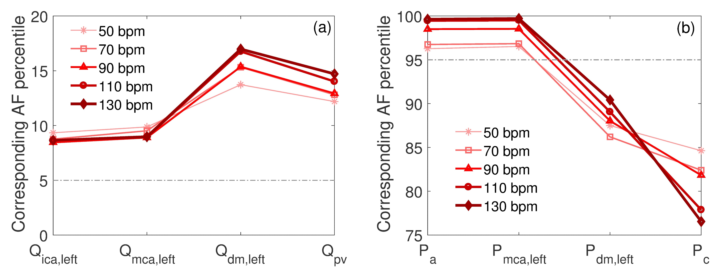
Results: percentile analysis
The higher variability during AF promotes extreme hemodynamic events of (a) reduced blood flow and (b) excessive pressure in the distal and capillary cerebral circulation, which increase with HR.

Slide 9
Results: crossing time evaluation
The ratio of the mean T_{cr} in AF to the mean T_{cr} in NSR:
↑ from proximal to distal circulation;
↑ with HR in the distal region.
PDFs of T_{cr} in AF: pronounced right tails and asymmetric shape, more evident for higher HR.
Alteration of the signal periodicity and temporal patterns.

Slide 10
Discussion and Conclusions
The impact of AF on cerebral microcirculation is a potential mechanism into the genesis of AF-related cognitive impairment → Potential damage either due to hypoperfusions (e.g., altered brain oxygenation) or hypertensive events (e.g., hemorrhagic episodes);
Percentile and crossing time analyses evidence the emergence of critical events:
Alteration of the cerebral hemodynamic patterns;
Loss of the signal periodicity;
Higher recurrence of extreme values;
Critical events occur in the distal/capillary districts and increase with HR → no optimal HR target;
Strict rate control strategy (50<HR<70 bpm) could be beneficial in terms of cognitive outcomes in patients with permanent AF.
Compagnia di San Paolo is acknowledged for funding the present work within the Project CSTO160444 "Cerebral hemodynamics during atrial fibrillation".

